Slide 2
DEV 004 Desenvolvimento de Jogos com XNA Express
Rob Miles Microsoft MVP
rob@robmiles.com
Lecturer, University of Hull, United Kingdom
Notes:
In this slide, please provide the exact code session and title in Portuguese as it appears in agenda.

Slide 3
Patrocinadores
Notes:
This is the Sponsors slide

Slide 4
Agenda
The Video Games Business
Challenges Big and Small
XNA
For the Game Developer
For the Game Programmer
In the future
Why everyone should be writing games!

Slide 5
The Video Game Business The scale of the enterprise
Bigger than the movies?
GoldenEye the game made more than the film
Set to grow even more?
The potential of a connected, high performance, easy to program gaming appliance like the XBOX 360 in millions of homes is bound to lead to new opportunities.
Just about anything is could have some form of gaming tie-in
"Casual" games are a huge growth area

Slide 6
Developer Challenges Modern Games are hard to make
Modern games are extremely complex
They contain sounds, images, models and scripts as well as program code
Managing these is very difficult
Everything must be up to date
You need to determine which elements are part of the game
Game developers do not have the time to develop appropriate management tools
Software development tools are inappropriate

Slide 7
Developer Challenges Small teams can’t do it any more
Games are now big business
There are niche markets for things like the mobile platform, but the cost of developing, marketing and delivering a modern game is too much for the small developer
With the huge cost of game production, the publishers are much less likely to pursue novel gaming ideas
New games are often tied to movies or TV
Games are often sequels of older ones

Slide 8
Wny XNA? Xbox/DirectX New generation Architecture
XNA mission statement:
XNA enables studios and publishers to develop better games, more effectively, on all platforms
XNA Express mission statement:
Embrace the creator community on Microsoft platforms to make writing games significantly easier and establish a vibrant creator community

Slide 9
XNA for the Game Studio Managing the content with a pipeline
The XNA content “pipeline” provides a unified mechanism for the storage, processing and retrieval of resource items
A set of “importers” are provided for standard resource types
Developers can make their own importers if they want to expand the range of these
Content items are held in a typesafe manner within the repository

Slide 10
Content Management
Production Process
Content
Originate the content using appropriate tools
Import it into the repository (Content DOM)
Type managed
Process the content ready for runtime
Create binary content for released game
Code
Provide resources for the game
Use resources in gameplay code
Game DVD

Slide 11
XNA for the Games Studio The XNA Build Process
MSBUILD is the underlying build tool
A graphical tool for designing the build
Get dependency/utilisation information
Performs incremental builds
Can create your own custom build tools or integrate existing ones
Does not even restrict you to exclusively targeting Microsoft platforms

Slide 12
XNA for the Games Studio Making a nice place to work
One of my rules when starting a new project is:
Make yourself a nice place to work
Make it easy to deploy, test and debug
No manual intervention to build the system
Fully automated and instrumented tests
Good code management and re-factoring
XNA is based on Visual Studio 2005 Team Foundation Server
Good for "Agile Development"

Slide 13
XNA for the Games Studio XNA and Agile Development
The rich, integrated toolset that you get with XNA is very amenable to Agile Development
Pair programming
Rapid iteration (test – code – re-factor)
Test driven development
Has been shown to improve programmer productivity and reduce burnout
Has great potential in the games industry

Slide 14
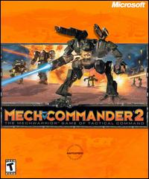
MechCommander 2
If you want to investigate the XNA build process you can download an entire game to work with
This includes all the game resources in the XNA content pipeline
You can build the game and see how build process works

Slide 15
XNA for the coder Based on .NET
Uses .NET Version 2.0
Games are written in C# 2.0
Generics
Properties
Partial classes
Games run as managed code
Secure program execution on a Virtual Machine
Signed code
Portable across platforms

Slide 16
XNA for the coder Getting started is really easy
If you have written games in the past you will have seen how hard it is to get started
Create your graphics device
Invoke lots of strange incantations
Handle mysterious events
XNA Express hides complexity from you
Games are written, deployed and debugged from within Visual Studio 2005 – even to the XBOX 360!

Slide 17
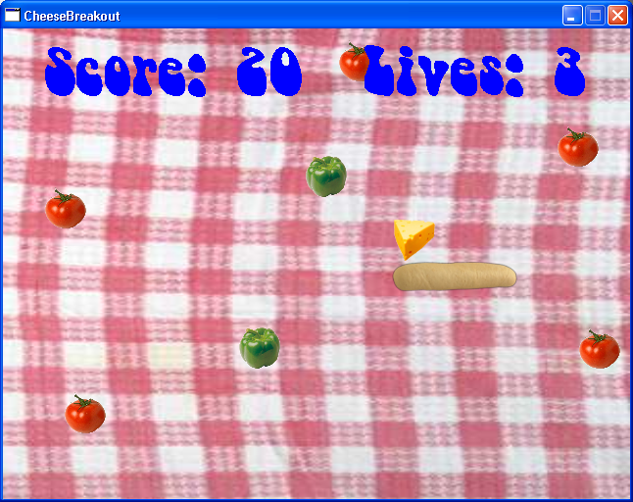
Sample XNA 2D game “Hot Salad Death with Cheese”
We are going to make a simple game
The player guides the cheese around with the bread, hitting the tomatoes but avoiding the peppers
This is a simple, 2D, sprite based game

Slide 18
XNA game construction Based on the way games work
Every game that has ever been written has these fundamental behaviours:
Initialise all the resources at the start
fetch all textures, models, scripts etc
Repeatedly run the game loop:
Update the game engine
read the controllers, update the state and position of game elements
Draw the game environment
render the game elements on the viewing device

Slide 19
XNA Game Skeleton
partial class Game1 : Microsoft.Xna.Framework.Game
{
public Game1() {
graphics = new GraphicsDeviceManager(this);
content = new ContentManager(Services); }
protected override void LoadGraphicsContent(bool loadAllContent) {
}
protected override void Update(GameTime gameTime) {
}
protected override void Draw(GameTime gameTime) {
} }

Slide 20
XNA Game Initialisation
Texture2D cheeseTexture;
SpriteBatch spriteBatch;
protected override void LoadGraphicsContent(bool loadAllContent) {
if (loadAllContent)
{
cheeseTexture = content.Load<Texture2D>("cheese");
spriteBatch = new SpriteBatch(graphics.GraphicsDevice);
}
}
LoadGraphicsContent is called when our game starts
It creates our cheese texture and loads an image into it
It also creates a SpriteBatch instance to manage the drawing process

Slide 21
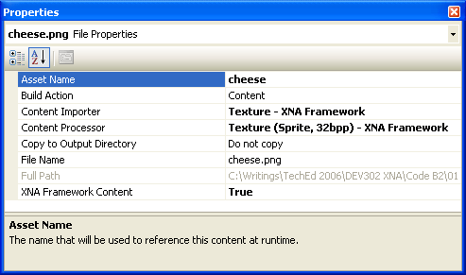
Using the Content Pipeline
The content pipeline manages the items as resources
Each is given an asset name
The Load method of ContentManager provides access to the resource
Note the use of generics
cheeseTexture =
content.Load<Texture2D>("cheese");

Slide 22
XNA Game Drawing
protected override void Draw(GameTime gameTime)
{
graphics.GraphicsDevice.Clear(Color.CornflowerBlue);
spriteBatch.Begin(SpriteBlendMode.AlphaBlend);
spriteBatch.Draw(cheeseTexture,
new Rectangle(
cheeseX, cheeseY,
cheeseTexture.Width, cheeseTexture.Height),
Color.White );
spriteBatch.End();
base.Draw(gameTime);
}

Slide 23
XNA Game Update
protected override void Update()
{
cheeseX = cheeseX + cheeseXSpeed;
if ((cheeseX <= 0) ||
(cheeseX + cheeseTexture.Width > Window.ClientBounds.Width))
{
cheeseXSpeed *= -1;
}
// repeat for Y
// Let the GameComponents update
UpdateComponents();
}

Slide 24
Bouncing Cheese
DEMO
Rob Miles
Microsoft MVP

Slide 25
Creating a bread bat
Now we need to create a bat texture and then allow the player to control it
XNA provides support for keyboard, mouse and XBOX 360 controller
You can plug a controller into an PC and it will just work
The game controller buttons can be polled during the update method
Note that we also need to handle potential controller disconnection

Slide 26
XNA Controller Reading
GamePadState padState = GamePad.GetState(PlayerIndex.One);
if (padState.IsConnected)
{
if (padState.DPad.Left == ButtonState.Pressed)
{
breadX--;
}
if (padState.DPad.Right == ButtonState.Pressed)
{
breadX++;
}
/// repeat for bread Y position
}

Slide 27
Cheese and a Bat
DEMO
Rob Miles Microsoft MVP

Slide 28
Analogue Input
int padXSpeed = 10;
int padYSpeed = 10;
GamePadState padState = GamePad.GetState(PlayerIndex.One);
if (padState.IsConnected)
{
breadX += (int) (padState.ThumbSticks.Left.X * padXSpeed);
breadY -= (int) (padState.ThumbSticks.Left.Y * padYSpeed);
}
This code uses the analogue input of the left thumbstick to control the position of the bread

Slide 29
Cheese and a Better Bat
DEMO
Rob Miles
Microsoft MVP

Slide 30
Adding a Background
Now we can add aa background texture
Use the component based design of XNA to create a background game item
We just have to extend the DrawableGameComponent class and implement LoadContent, Update and Draw methods
This is directly analogous to components in Windows Forms

Slide 31
Adding a Backdrop
DEMO
Rob Miles
Microsoft MVP

Slide 32
Displaying Text
The XNA framework does not support text
I render a set of characters to a bitmap and then copy the characters from the bitmap into the display area
I have implemented this as another component
This gets the text to be displayed from the game instance and then draws it on the screen

Slide 33
Adding Sound
Sound makes a huge difference to a game
XNA has very powerful sound creation facilities
The Microsoft Cross Platform Audio Creation Tool (XACT) is used to create soundbanks which are loaded by the game
This tool is provided as part of the XNA Express distribution
The sound banks are managed by the content manager

Slide 34
The Finished Game
DEMO
Rob Miles Microsoft MVP

Slide 35
Moving into 3D
Using 2D with flat sprites is rather old hat
Although a great deal of very playable games are only 2D and many games on XBOX Live Arcade are actually 2D
You can make them appear 3D even though the gameplay is just 2D
XNA has full support for 3D
The content manager will upload models (.fbx files)
Best to start with 2D though

Slide 36
Spacewar Project
DEMO
Rob Miles Microsoft MVP

Slide 37
XNA and the XBOX 360
All the software is free:
Visual Studio 2005 Express Edition
XNA Game Studio
Games can be deployed on the XBOX 360
The code just needs a few changes
You can even write shaders (HLSL)
You need to join the "Creators Club" in order to deploy games to an XBOX 360

Slide 38
Call to Action! Why we should all be writing games
It is easy
XNA and .NET lower the difficulty bar and make it possible to target a range of platforms
Using .NET gives games integrity and reliability right out of the box
You might make money
There is a market for “casual” games which are quick to play
It is fun!
Any developer can write viable games and enjoy doing it

Slide 39
Resources
Microsoft XNA on the Web
http://msdn.microsoft.com/directx/XNA/default.aspx
Microsoft XNA blogs
http://blogs.msdn.com/xna/
All the sample code and resource links:
http://www.robmiles.com/xna

Slide 40
Summary
XNA for Game Development in the large
Content Management
Build System
XNA for Game Development in the small
XNA Express
You should be writing games
More fun than playing them?

Slide 41
Recursos Úteis
Microsoft XNA on the Web
http://msdn.microsoft.com/directx/XNA/default.aspx
Microsoft XNA blogs
http://blogs.msdn.com/xna/
All the sample code and resource links:
http://www.robmiles.com/xna
Notes:
This is the usefull resources slide

Slide 42
Q&A

Slide 43
Outros Recursos Para Profissionais de TI
TechNet Plus
2 incidentes de suporte gratuito profissional
software exclusivo: Capacity Planner
software Microsoft para avaliação
actualizações de segurança e service packs
acesso privilegiado à knowledge base
formação gratuita
e muito mais.
www.microsoft.com/portugal/technet/subscricoes

Slide 44
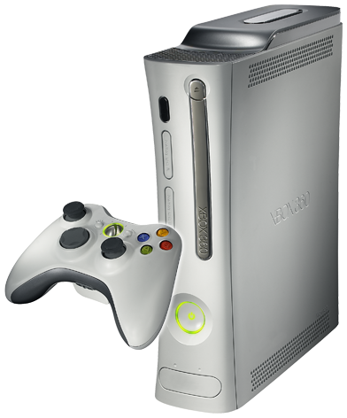
Questionário de Avaliação Passatempo!
Complete o questionário de avaliação e devolva-o no balcão da recepção.
Habilite-se a ganhar uma Xbox 360 por dia!
DEV004 Desenvolvimento de Jogos com XNA Express

Slide 45
© 2007 Microsoft Corporation. All rights reserved.
This presentation is for informational purposes only. Microsoft makes no warranties, express or implied, in this summary.

